Slide 1
信息的表示和处理(2)
柴云鹏
2025.10

Slide 2
Outline
Integers
  Representation: unsigned and signed
  Conversion, casting
  Expanding, truncating
  Addition, negation, multiplication, shifting
  Summary

Slide 3
Unsigned Representation
Binary (physical)
  Bit vector [x_{w-1},x_{w-2},x_{w-3},…x₀]
Binary to Unsigned (logical)
例如：N₁=01011，表示无符号数11;
N₂=11011 表示无符号数27;
N₃=00000 表示无符号数0。

Slide 4
Unsigned Representation
如果机器字长为n位，则无符号数的表示范围是：
0～(2^{n}-1)。
例如字长为8位，则无符号数的表示范围是0～255。
计算机的内存地址就是无符号数的例子。

Slide 5
Signed Representation
Binary原本的含义与非负整数正好对应
负数如何用binary表达？
  解决思路：映射(mapping)
  将负数段映射到一个不使用的非负数段
    对有限范围的整数成立
    最好不影响正数和0
  且最好负数和映射到的整数在某种意义上是“等价”的，可以直接进行运算

Slide 6
补码的映射关系
UMax
15
UMax – 1
TMax + 1
Unsigned
Range
8
TMax
TMax
7
2’s Comp.
Range
0
0
0
-1
–1
–2
TMin
-8

Slide 7
Signed Representation
假设时钟停在 8点，而现在正确的时间是6点，这时拨准时钟的方法有两种：
  一是将分针倒着旋转2圈（即时钟倒拨2小时），8-2=6（做减法）
  另一种方法是将分针正着旋转 10圈（即时钟正拨10小时），8+10=6（mod 12）（做加法）
此时： 8-2 = 8+10 (mod 12)
所以有：-2=10 (mod 12) ，即-2和10同余。
同余的两个数，具有互补关系，-2和10 对模12互补，也就是-2的补数是10（以12为模）

Slide 8
Signed Representation
补码表示法
只要确定了“模”，就可找到一个与负数等价的正数（该正数即为负数的补数）来代替此负数，而这个正数可以用模加上负数本身求得，这样就可把减法运算用加法实现了。
例： 9-5=9+(12-5)=9+7=4 (mod 12)
65-25=65+(-25)=65+(100-25)=65+75=40 (mod 100)

Slide 9
Two’s Complement
Binary (physical)
  Bit vector [x_{w-1},x_{w-2},x_{w-3},…x₀]
Binary to Signed (logical)
2’s complement
  “模”就是2^{w}
  因为binary形式的值是2^{w-1}+…，实际值是-2^{w-1}+…，二者相差2^{w}
  w位，有2^{w}个状态，
  所以模就是2^{w} ；
  增加或减少2^{w}，值不变
Sign
Bit

Slide 10
补码和真值的关系
如果是非负数
  二者一致
如果是负数，那么x的补码形式为
其真值为x
  假设真值的绝对值为y，那么y = -x
  y的二进制形式为

Slide 11
补码和真值的关系
等比数列求和 S_{n}=a₁(q^{n}-1)/(q-1)

Slide 12
Binary Number Property
Claim
1 + 1 + 2 + 4 + 8 + … + 2^{w-1} = 2^{w}
w = 0:
  1 = 2⁰
Assume true for w-1:
  1 + 1 + 2 + 4 + 8 + … + 2^{w-1} + 2^{w} = 2^{w} + 2^{w} = 2^{w+1}
= 2^{w}

Slide 13
Two’s Complement
真值绝对值
补码
What does it mean?
  建立补码binary [x_{w-1},…,x₀]和真值binary [y_{w-1},…,y₀]之间每一位的关系
  已知真值(-y)，求补码x，x的binary形式获得方法为
    取y的binary [y_{w-1},…,y₀] （w-bits）
    每一位都取反
    最后加1
  =>反过来已知补码x，求真值-y，也是同样的方法
=>[x_{w-1},…,x₀]+[y_{w-1},…,y₀]=2^{w}

Slide 14
From a Number to Two’s Complement
真值-5
  -5+16 = 11
  y=5
  0101 (binary for 5)
  1010 (after complement)
  1011 (add 1)
  补码x为1011
真值 ←→ 补码：
1）模-真值绝对值/补码
（如10000-0101）
2）每一位都取反，最后加1

Slide 15
From Two’s Complement to Number
补码x=1011
  1011 (two’s complement binary)
  0100 (after complement)
  0101 (add 1)
  Y=0101, 真值-y=-5

Slide 16
Two’s Complement Encoding Examples
Binary/Hexadecimal Representation for -12345
Binary: 0011 0000 0011 1001 (12345)
Hex: 3 0 3 9
Binary: 1100 1111 1100 0110 (after complement)
Hex: C F C 6
Binary: 1100 1111 1100 0111 (add 1)
Hex: C F C 7

Slide 17
Numeric Range
Unsigned Values
  Umin=0
  Umax=2^{w}-1
Two’s Complement Values
  Tmin = -2^{w-1}
  Tmax = 2^{w-1}-1
E.g., w=4
0000 ~ 0111: 0~7
1000 ~ 1111: -8~-1
⁻⁽⁰¹¹¹⁺¹⁾ ⁻⁽⁰⁰⁰⁰⁺¹⁾

Slide 18
Values for Different Word Sizes
Observations
  |TMin | = TMax + 1
    Asymmetric range
  UMax = 2 * TMax + 1
C Programming
  #include <limits.h>
  Declares constants, e.g.,
    ULONG_MAX
    LONG_MAX
    LONG_MIN
  Values platform specific

Slide 19
Alternative representations of signed numbers
Ones’ Complement (反码)
  The most significant bit has weight 2^{w-1}-1
Sign-Magnitude (原码)
  The most significant bit is a sign bit
    that determines whether the remaining bits should be given negative or positive weight

Slide 20
X
B2U(X)
B2T(X)
0000
0
0
0001
1
1
0010
2
2
0011
3
3
0100
4
4
0101
5
5
0110
6
6
0111
7
7
1000
8
–8
1001
9
–7
1010
10
–6
1011
11
–5
1100
12
–4
1101
13
–3
1110
14
–2
1111
15
–1

Slide 21
Relation Between 2’s Comp. & Unsigned
Two’s Complement
T2U
Unsigned
x
T2B
B2U
ux
X
Maintain Same Bit Pattern
w–1
0
二进制形式不变，
理解方式不同
（负数变正数）
ux
+
+
+
• • •
+
+
+
-
x
-
+
+
• • •
+
+
+
+2^{w–1} – –2^{w–1} = 2*2^{w–1} = 2^{w}

Slide 22
Conversion between two Representations
UMax
2^{w}-1
UMax – 1
TMax + 1
2^{w-1}
Unsigned
Range
2^{w-1}-1
TMax
TMax
2^{w-1}-1
2’s Comp.
Range
0
0
–1
–2
-2^{w-1}
TMin

Slide 23
课堂练习
求+0.1101、-0.1101的补码
写出下列数字的补码（short类型）【16进制】
  -178
char x =10110111b
  如果是补码，则真值是多少？
Notes:
-178，补码：1111 1111 0100 1110 FF4E

Slide 24
课堂测试
写出下列数字的补码（short类型）【16进制】
  -39
  -26
下面给出了一组short类型的变量在计算机内的编码（补码），请写出他们的真值(16进制形式)。
  FF3C
  FF86

Slide 25
Outline
Integers
  Representation: unsigned and signed
  Conversion, casting
  Expanding, truncating
  Addition, negation, multiplication, shifting
  Summary

Slide 26
Integral data type in C
Signed type (for integer numbers)
  char, short [int], int, long [int]
Unsigned type (for nonnegative numbers)
  unsigned char, unsigned short [int], unsigned [int], unsigned long [int]
Java 没有无符号类型
  Byte: signed char

Slide 27
Integral Data Types
C supports a variety of integral data types
  Represent a finite range of integers
C declaration | guaranteed |  | Typical 32-bit
 | minimum | maximum | minimum | maximum
char unsigned char | -127 0 | 127 255 | -128 0 | 127 255
short [int] unsigned short | -32,767 0 | 32,767 65,535 | -32,768 0 | 32,767 65,535
int unsigned [int] | -32,767 0 | 32,767 65,535 | -2,147,483,648 0 | 2,147,483,647 4,294,967,295
long [int] unsigned long | -2,147,483,647 0 | 2,147,483,647 0 | -2,147,483,648 0 | 2,147,483,647 4,294,967,295

Slide 28
Casting among Signed and Unsigned in C
C允许一种类型按照另一种类型的方式来理解
  Type conversion (implicitly)
  Type casting (explicitly)

Slide 29
Signed vs. Unsigned in C
Casting
  Signed和unsigned类型之间的显式转换
  即 U2T 和 T2U
    int tx, ty;
    unsigned ux, uy;
    tx = (int) ux;
    uy = (unsigned) ty;

Slide 30
Signed vs. Unsigned in C
Conversion
  通过赋值语句或call语言（函数调用）来隐式转换
    int tx, ty;
    unsigned ux, uy;
    tx = ux;
    uy = ty;
    int func () {…}
    unsigned ux = func();

Slide 31
Casting from Signed to Unsigned
short int x = 12345;
unsigned short int ux = (unsigned short) x;
short int y = -12345;
unsigned short int uy = (unsigned short) y;
转换的结果结果
  非负值不变
    ux = 12345
  负值被转为(更大的)正值
    uy = 53191

Slide 32
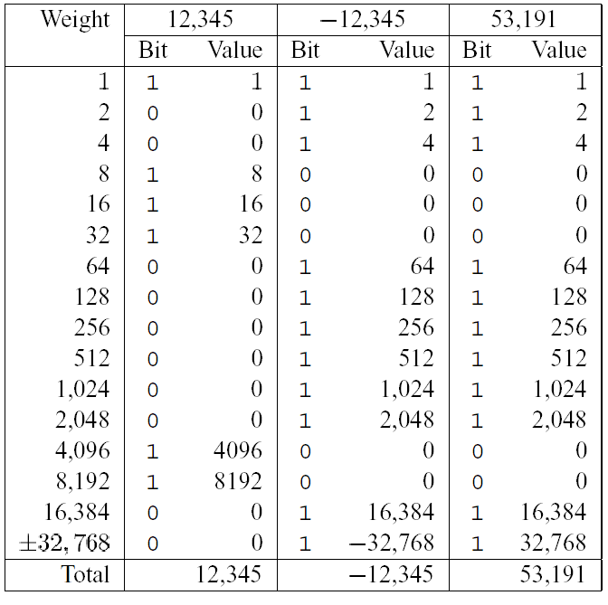
back

Slide 33
Unsigned Constants in C
默认情况
  常量被当作有符号数
如果希望是无符号数，在后面加上后缀U
  0U, 4294967259U

Slide 34
Casting Convention
表达式比较
  如果在一个表达式中混用unsigned和signed
    会隐式地把有符号数专为无符号数
  包括 <, >, ==, <=, >= 等比较符号
  Examples for W = 32
    TMIN = -2,147,483,648 , TMAX = 2,147,483,647

Slide 35
Casting Convention
Constant1 Constant2 Relation Evaluation
  0 0U == unsigned
  -1 0 < signed
  -1 0U > unsigned
  2147483647 -2147483648 > signed
  2147483647U -2147483648 < unsigned
  -1 -2 > signed
  (unsigned)-1 -2 > unsigned

Slide 36
Outline
Integers
  Representation: unsigned and signed
  Conversion, casting
  Expanding, truncating
  Addition, negation, multiplication, shifting
  Summary

Slide 37
From short to long
short int x = 12345;
int ix = (int) x;
short int y = -12345;
int iy = (int) y;
需要扩展数据大小
在无符号数据之间转换(casting)正常处理即可
在有符号数据之间转换(casting)需要特别注意

Slide 38
Expanding the Bit Representation
Zero extension
  在前面添加0
Sign extension
  [x_{w-1},x_{w-2},x_{w-3},…x₀]
w
X
• • •
X
-
• • •
• • •
X ′
X ′
• • •
• • •
-
+
• • •
w+1

Slide 39
From short to long
short int sx = 12345; ：0x0309
int x = (int) sx; : 0x00000309
short int sy =-12345;: 0xcfc7
int y = (int) sy; : 0xffffcfc7

Slide 40
From short to long
int fun1(unsigned word) {
return (int) ((word << 24) >> 24);
}
int fun2(unsigned word) {
return ((int) word << 24) >> 24;
}
w fun1(w) fun2(w)
0x00000076
0x87654321
0x000000C9
0xEDCBA987
练习：描述一下两个函数的行为区别
00000076 00000076
00000021 00000021
000000C9 FFFFFFC9
00000087 FFFFFF87

Slide 41
From long to short
int x = 53191;
short int sx = x;
int y = -12345;
Short int sy = y;
需要截断数据大小
从长类型到短类型转换需要特别注意

Slide 42
Truncating Numbers
 | Decimal | Hex | Binary
x | 53191 | 00 00 CF C7 | 00000000 00000000 11001111 11000111
sx | -12345 | CF C7 | 11001111 11000111
y | -12345 | FF FF CF C7 | 11111111 11111111 11001111 11000111
sy | -12345 | CF C7 | 11001111 11000111
X ′
• • •
• • •
X
• • •

Slide 43
Truncating Numbers
Unsigned Truncating
Signed Truncating
  先当作无符号数去截断，然后转换为有符号数

Slide 44
Advice on Signed vs. Unsigned
Non-intuitive Features
float sum_elements ( float a[], unsigned length )
{
int i;
float result = 0;
for ( i = 0; i <= length – 1; i++)
result += a[i] ;
}
当length=0时，应该返回0.0，但实际会遇到内存错误，为什么？

Slide 45
Advice on Signed vs. Unsigned
/* Prototype for library function strlen */
size_t strlen(const char *s); /*size_t is unsigned */
/* Determine whether string s is longer than string t */
/* WARNING: This function is buggy */
int strlonger(char *s, char *t) {
return strlen(s) - strlen(t) > 0;
}

Slide 46
Advice on Signed vs. Unsigned
1 /*
2 * Illustration of code vulnerability similar to that found in
3 * FreeBSD’s implementation of getpeername (…)
4 * */
5
6 /* Declaration of library function memcpy */
7 void *memcpy(void *dest, void *src, size_t n);
8

Slide 47
Advice on Signed vs. Unsigned
9 /* Kernel memory region holding user-accessible data */
10 #define KSIZE 1024
11 char kbuf[KSIZE];
12
13 /* Copy at most maxlen bytes from kernel region to user buffer */
14 int copy_from_kernel (void *user_dest, int maxlen) {
15 /* Byte count len is minimum of buffer size and maxlen */
16 int len = KSIZE < maxlen ? KSIZE : maxlen;
17 memcpy(user_dest, kbuf, len); // 如果maxlen是个负值
18 return len;
19 }

Slide 48
Outline
Integers
  Representation: unsigned and signed
  Conversion, casting
  Expanding, truncating
  Addition, negation, multiplication, shifting
  Summary

Slide 49
Unsigned Addition
u
• • •
Operands: w bits
+
v
• • •
True Sum: w+1 bits
u + v
• • •
Discard Carry: w bits
UAdd_{w}(u , v)
• • •

Slide 50
Unsigned Addition
Standard Addition Function
  Ignores carry output
Implements Modular Arithmetic
  s = UAddw(u , v) = (u + v) mod 2^{w}

Slide 51
Unsigned Addition
Practice Problem 2.27
Write a function with the following prototype:
/* Determine whether arguments can be added without overflow */
int uadd_ok(unsigned x, unsigned y);
This function should return 1 if arguments x and y can be added without causing overflow
  Overflow iff (X+Y) < X

Slide 52
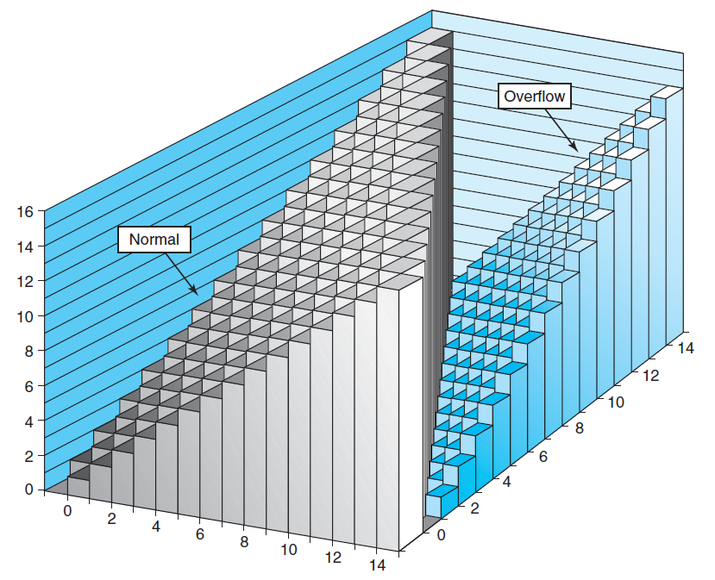
Unsigned Addition
2^{w+1}
Overflow
2^{w}
0
Modular Sum

Slide 53
Unsigned Addition Forms an Abelian Group (阿贝尔群)
加法结果是封闭的（还在同样的数据范围内）
  0 ≤ UAdd_{w}(u , v) ≤ 2^{w} –1
交换律
  UAdd_{w} (t, UAdd_{w} (u,v)) = UAdd_{w} (UAdd_{w} (t, u ), v)
有一个单位元0
  UAdd_{w} (u , 0) = u

Slide 54
Unsigned Addition Forms an Abelian Group
每个元素都有一个加法逆元
  Let UComp_{w} (u ) = 2^{w} – u
  UAddw(u , UComp_{w} (u )) = 0
交换律
  UAdd_{w}(u , v) = UAdd_{w}(v , u)

Slide 55
Signed Addition
Functionality
  真正的结果需要w+1 bits
  但实际只有w bits, 会丢掉最高位
  将结果bits视为补码整型

Slide 56
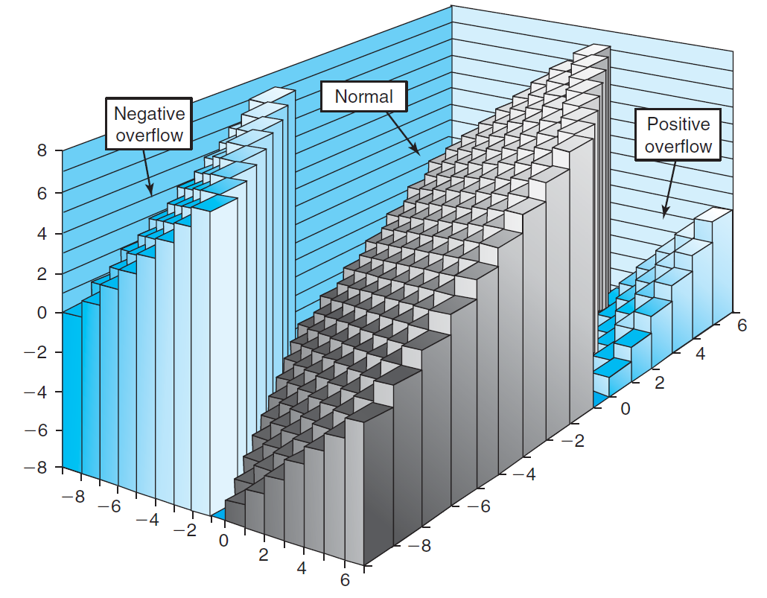
Signed Addition

Slide 57
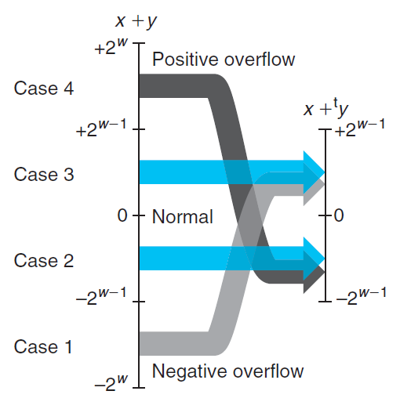
Signed Addition

Slide 58
Detecting Tadd Overflow
Task
  Given s = TAdd_{w}(u , v)
  Determine if s = Add_{w}(u , v)
Claim
  Overflow iff either:
    u, v < 0, s ≥ 0 (NegOver)
    u, v ≥ 0, s < 0 (PosOver)
  ovf = (u<0 == v<0) && (u<0 != s<0);

Slide 59
Detecting Tadd Overflow
int tadd_ok_bugy(int x, int y)
{
int sum = x + y ;
return (sum-x == y) && (sum-y == x)
} // 问题在哪？
e.g., [-8, 7), x=4, y=5
//应该如何正确判断加法溢出？
Notes:
tadd是阿贝尔群，结果封闭（越界则加上或减少2^w），所以sum-x = x+y-x永远等于y（因为y就在合法区间，不会加减2^w）。此函数无法判定溢出。
例如表示范围是-8～+7，x=4, y=5, sum=9=-7. sum-x = -7-4=-11=5=y（-11还是会被拉回到5）

Slide 60
Detecting Tadd Overflow
int tadd_ok (int x, int y)
{
int sum = x + y ;
return !((x>0&&y>0&&sum<0) || (x<0&&y<0&&sum>0))
}

Slide 61
Detecting Tsub Overflow
int tsub_ok(int x, int y)
{
return tadd_ok(x, -y) ;
} // 问题在哪？
e.g., x>0, y=TMin; x<0, y=TMin; x=0, y=TMin
//写一个正确版本
Notes:
Y=Tmin, -y越界，还是被当作y（负数），y的符号错了。
如果x是正数，判定是异号相加，肯定不溢出，但实际是正数-Tmin，肯定溢出。
如果x是负数，会判定溢出，实际不溢出。
如果x=0，会判定不溢出，实际溢出。

Slide 62
Detecting Tsub Overflow
int tsub_ok(int x, int y)
{
int diff = x-y;
return !(x>=0&&y<0&&diff<0 || x<0&&y>0&&diff>0) // 0减正数 不会溢出
}
只有: 1)正数/0-负数，或2)负数-正数可能溢出

Slide 63
Mathematical Properties of TAdd
Two’s Complement Under TAdd Forms a Group
  Closed, Commutative, Associative, 0 is additive identity
  Every element has additive inverse
    Let
    TAdd_{w}(u , TComp_{w} (u )) = 0

Slide 64
Mathematical Properties of TAdd
TAdd和Uadd：
  TAdd_{w} (u , v) = U2T (UAdd_{w}(T2U(u ), T2U(v)))
    因为二者有相同的位级表示
  T2U(TAdd_{w} (u , v)) = UAdd_{w}(T2U(u ), T2U(v))

Slide 65
Negating with Complement & Increment
x
1
0
0
1
1
1
0
1
In C
  ~x + 1 == -x
Complement
  Observation: ~x + x == 1111…111 == -1
Increment
  ~x + 1 == -x
+
~x
0
1
1
0
0
0
1
0
-1
1
1
1
1
1
1
1
1

Slide 66
Multiplication
计算w-bit的数字x, y的乘积
  无符号数乘法规则，类似于10进制乘法，如101*110=11110
范围
  Unsigned: 0 ≤ x * y ≤ (2^{w} – 1) ² = 2^{2w} – 2^{w+1} + 1
    Up to 2w bits
  Two’s complement min: x *y ≥–2^{w–1}*(2^{w–1}–1) = –2^{2w–2} + 2^{w–1}
    Up to 2w bits
  Two’s complement max: x * y ≤ (–2^{w–1}) ² = 2^{2w–2}
    Up to 2w bits
^{C语言进行乘法，会自动进行截断}
  ^{Int x,y; m=x*y;}

Slide 67





Multiplication
Unsigned
Signed
Given two bit vectors and
is identical to
in binary

Slide 68
Multiplication
unsigned和signed乘法截断为w时，结果的binary形式是一样
 | x |  | y |  | x*y |  | 截断的x*y
无符号 | 5 | [101] | 3 | [011] | 15 | [001111] | 7 | [111]
补码 | -3 | [101] | 3 | [011] | -9 | [001111] | -1 | [111]
无符号 | 4 | [100] | 7 | [111] | 28 | [011100] | 4 | [100]
补码 | -4 | [100] | -1 | [111] | 4 | [000100] | -4 | [100]
无符号 | 3 | [011] | 3 | [011] | 9 | [001001] | 1 | [001]
补码 | 3 | [011] | 3 | [011] | 9 | [001001] | 1 | [001]

Slide 69
Multiplication
要得到精确的结果
  需要扩展乘积的数据大小是乘数和被乘数的两倍
如何判定乘法是否溢出？
  Int tmult_ok(int x, int y);
    Int p=x*y; return !x||p/x==y;
    或
    Int64_t l=(int64_t)x*y; return l==(int)l;
    // 如果用int64_t l = x*y, 则会先计算32位乘积（可能溢出），然后再符号扩展到64位

Slide 70
Power-of-2 Multiply with Shift
k
u
• • •
Operands: w bits
*
2^{k}
0
•••
0
1
0
•••
0
0
True Product: w+k bits
u · 2^{k}
• • •
0
•••
0
0
Discard k bits: w bits
UMult_{w}(u , 2^{k})
•••
0
•••
0
0
TMult_{w}(u , 2^{k})

Slide 71
Power-of-2 Multiply with Shift
Operation
  u << k gives u * 2^{k}
  Both signed and unsigned
Examples
  u << 3 == u * 8
  (u << 5) – (u << 3) == u * 24
  绝大多数计算机的移位和加法运算远比乘法要快
    编译器一般会自动做这样的代码优化

Slide 72
Signed Power-of-2 Divide with Shift
有符号数除以2的整数幂
  x >> k = ⎣ x / 2^{k} ⎦
  使用算数移位，保持符号不变
  Rounds wrong direction when u < 0
k
x
•••
•••
Binary Point
Operands:
/
2^{k}
0
•••
0
1
0
•••
0
0
Division:
x / 2^{k}
0
•••
•••
.
•••
Result:
RoundDown(x / 2^{k})
0
•••
•••
*补码为线性映射，binary大小与实际数据大小增减方向相同

Slide 73
Correct Power-of-2 Divide
负数除以2的整数幂的商
  Want ⎡ x / 2^{k} ⎤ (Round Toward 0)
  Compute as ⎣ (x+2^{k}-1)/ 2^{k} ⎦
    In C: (x + (1<<k)-1) >> k
    Biases(编置) dividend toward 0
Case 1: No rounding
k
Dividend:
u
1
•••
0
•••
0
0
+2^{k} –1
0
•••
0
0
1
•••
1
1
Binary Point
1
•••
1
•••
1
1
Divisor:
/
2^{k}
0
•••
0
1
0
•••
0
0
⎡ u / 2^{k} ⎤
0
.
1
•••
1
1
1
•••
1
•••
1
1
    Biasing has no effect

Slide 74
Correct Power-of-2 Divide (Cont.)
Case 2: Rounding
k
Dividend:
x
1
•••
•••
+2^{k} –1
0
•••
0
0
1
•••
1
1
1
•••
•••
Incremented by 1
Binary Point
Divisor:
/
2^{k}
0
•••
0
1
0
•••
0
0
⎡ x / 2^{k} ⎤
.
0
1
•••
1
1
1
•••
•••
Incremented by 1
    Biasing adds 1 to final result

Slide 75
Compiled Signed Division Code
C Function
long idiv8(long x)
{
return x/8;
}
Compiled Arithmetic Operations
Explanation
testq %rax, %rax
js L4
L3:
sarq $3, %rax
ret
L4:
addq $7, %rax
jmp L3
if x < 0
x += 7;
# Arithmetic shift
return x >> 3;
Uses arithmetic shift for int
For Java Users
  Arith. shift written as >>

Slide 76
Security Vulnerability in the XDR Library
1 /*
2 * Illustration of code vulnerability similar to that found in
3 * Sun’s XDR library.
4 */

Slide 77
Security Vulnerability in the XDR Library
5 void* copy_elements(void *ele_src[], int ele_cnt, size_t ele_size) {
6 /*
7 * Allocate buffer for ele_cnt objects, each of ele_size bytes
8 * and copy from locations designated by ele_src
9 */
10 void *result = malloc(ele_cnt * ele_size);
11 if (result == NULL)
12 /* malloc failed */
13 return NULL;

Slide 78
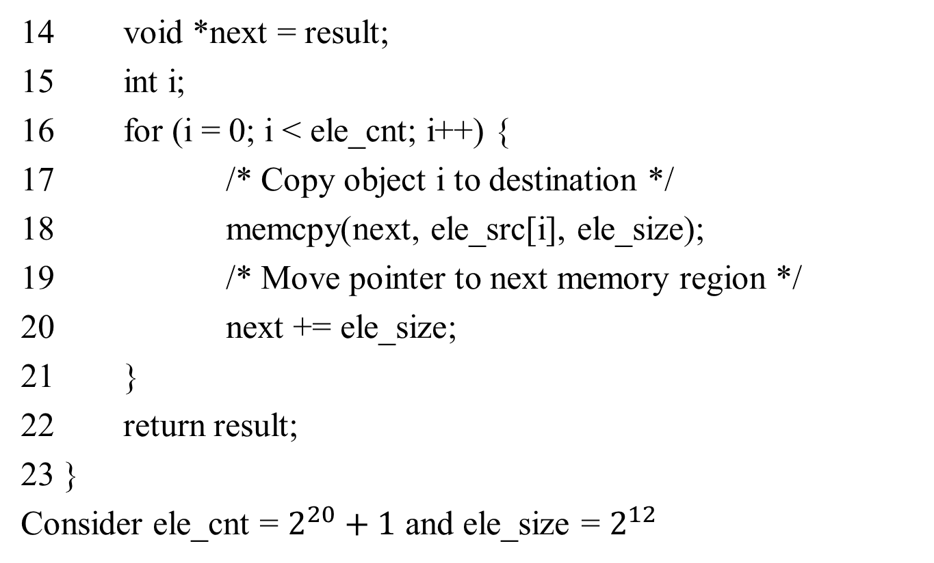
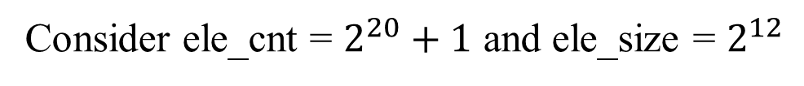
Security Vulnerability in the XDR Library
on
乘积被截断为4096，result数组大小只有4096

Slide 79
Outline
Integers
  Representation: unsigned and signed
  Conversion, casting
  Expanding, truncating
  Addition, negation, multiplication, shifting
  Summary

Slide 80
Arithmetic: Basic Rules
加法：
  Unsigned/signed: 先正常加，再截断，二者在bit级的操作完全一样
  Unsigned: 相加后模2^{w}
    正常加法结果 + 可能减去2^{w}
  Signed:相加后模2^{w}
    正常加法结果 + 可能加上或减去2^{w}

Slide 81
Arithmetic: Basic Rules
加法：
  Unsigned/signed: 先正常加，再截断，二者在bit级的操作完全一样
  Unsigned: 相加后模2^{w}
    正常加法结果 + 可能减去2^{w}
  Signed:相加后模2^{w}
    正常加法结果 + 可能加上或减去2^{w}
乘法：
  Unsigned/signed: 先正常乘，在截断，二者在bit级的操作完全一样（结果也为w bits）
  Unsigned: 乘积模2^{w}
  Signed:乘积模2^{w}

