Slide 1
Homework7

Slide 2
Homework7-asm-basics
题目1
  Assume we have following address binding table and value of registers :
Address | Value | Register | Value
0x100 | 0x10 | %eax | 0x10
0x110 | 0x11 | %ebx | 0x100
0x120 | 0x12
...... | ......
0x190 | 0x19
0x200 | 0x20

Slide 3
Homework7-asm-basics
题目1
  Please fill in the table below
Operand | Value
%ebx | 0x100
$0x150 | 0x150
0x170 | 0x17
(%ebx) | 0x10
(%ebx,%eax) | 0x11
0x30(%ebx) | 0x13
80(%ebx,%eax,2) | 0x17 (80=16*5)

Slide 4
Homework7-asm-basics
题目1
  Suppose registers and bound values will be reset as above after each instruction. Please fill in the table below: (Write all if there are more than one destinations and None if there is no destination)
Instruction | Dstination | Value
addl %eax,%ebx | %ebx | 0x110
subl %eax,(%ebx) | (%ebx) | 0x0
leal 0x50(%eax), %edx | %edx | 0x60
movzbl %al, %ebx | %ebx | 0x10
movsbl %bh, %ecx | %ecx | 0x01

Slide 5
Homework7-asm-basics
题目1
  Assume the initial value of the flags is 0. Fill the table below
Instruction | OF | SF | ZF | CF
leal(%eax),%ebx | 0 | 0 | 0 | 0
subl %ebx, %eax | 0 | 1 | 0 | 1
xorl %eax, %eax | 0 | 0 | 1 | 0
test %eax, %ebx | 0 | 0 | 1 | 0

Slide 6
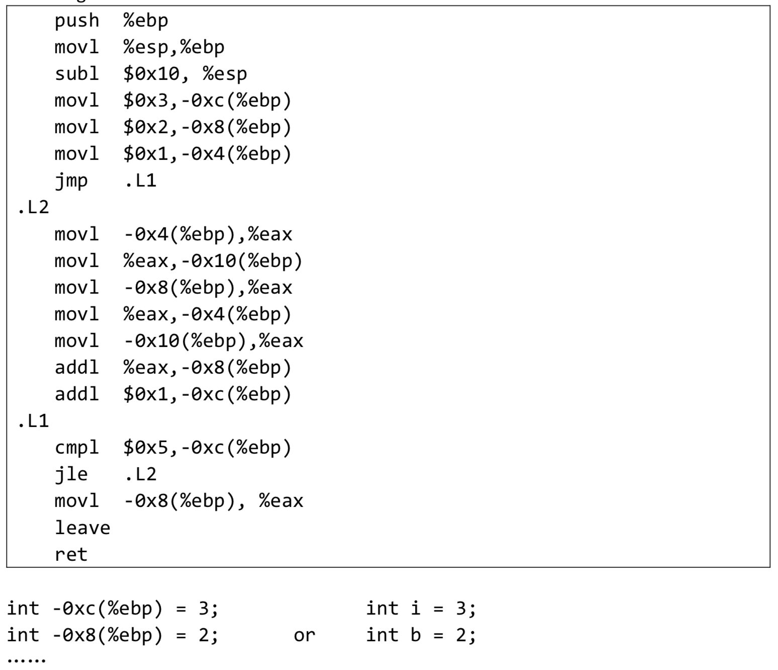
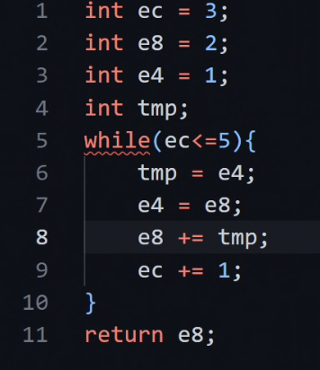
Homework7
题目2
  Translate the following assembly into C codes.
  You can name local variables represented by -12(%ebp), -8(%ebp)...or a,b,c... freely as you like.
  The beginning of C codes is given.

