Slide 1
Homework5

Slide 2
Homework5
题目1
  Consider the following function
  typedef unsigned char * byte_pointer;
  void show_bytes(byte_pointer start, int len) {
    int i;
    for (i=0; i<len; i++)
      printf(“%.2x”, start[i]);
    }
  int val = 0x140A0233;
  byte_pointer valp = (byte_pointer) & val;

Slide 3
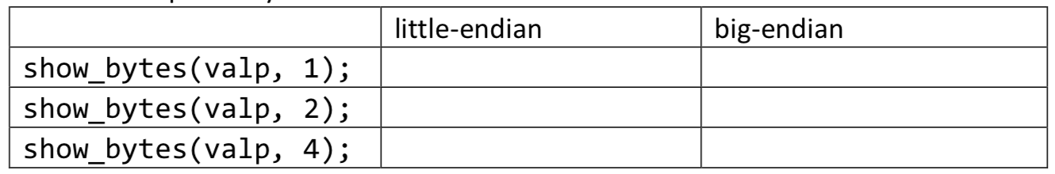
Homework5
题目1
  What is the output of the following call to show_bytes on big-endian and little-endian machines respectively?

Slide 4
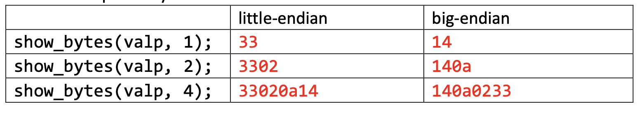
题目1答案

Slide 5
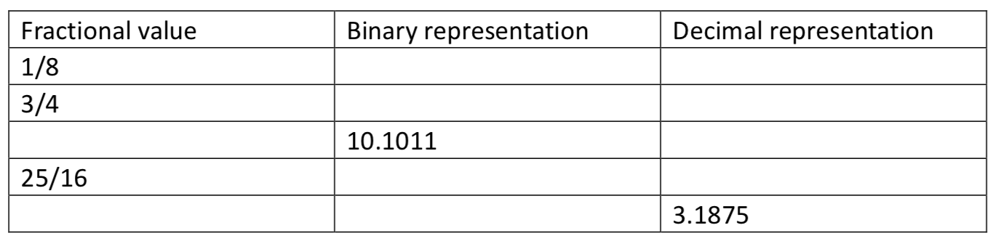
Homework5
题目2
  Fill in the missing information in the following table:

Slide 6
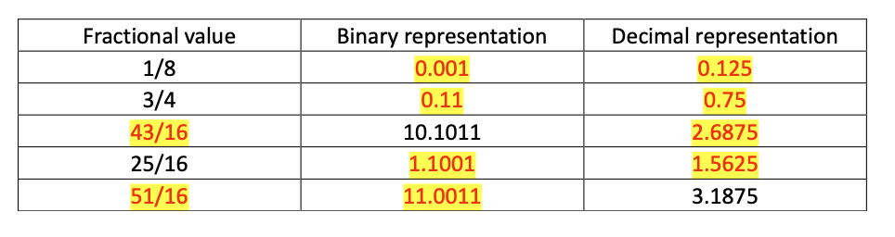
题目2答案

Slide 7
Homework5
题目3
  Given a floating-point format with a k-bit exponent and an n-bit fraction, write formulas for the exponent E, significand M, the fraction f, and the value V for the quantities that follow. In addition, describe the bit representation.
  A. The number 5.0
  B. The largest odd integer that can be represented exactly
  C. The reciprocal of the smallest positive normalized value

Slide 8
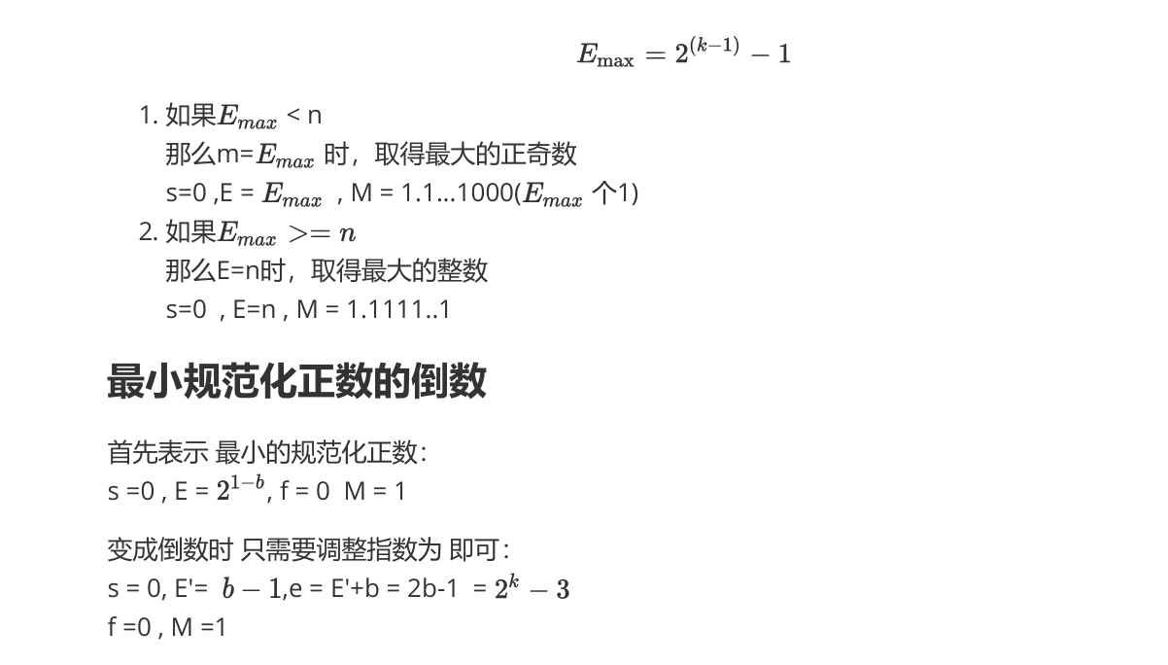
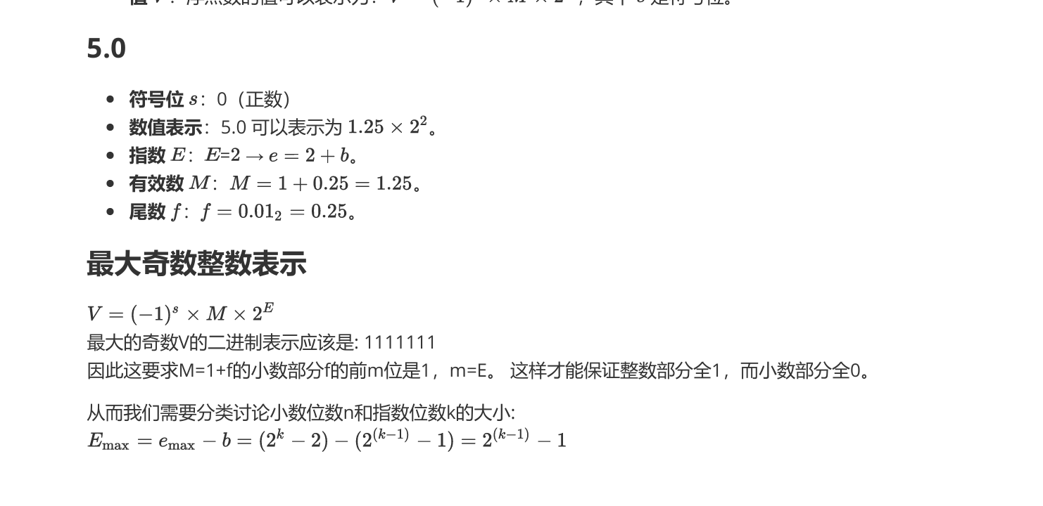
Homework5
题目3答案

Slide 9
Homework5
题目4
  Consider the following two 9-bit floating-point representations based on the IEEE floating-point format.
  Format A
    There is one sign bit.
    There are k = 5 exponent bits. The exponent bias is 15.
    There are n = 3 fraction bits.
  Format B
    There is one sign bit.
    There are k = 4 exponent bits. The exponent bias is 7.
    There are n = 4 fraction bits.

Slide 10

Homework5
题目4
  Below, you are given some bit patterns in Format A, and your task is to convert them to the closest value in Format B. If rounding is necessary, you should round toward
  In addition, give the values of numbers given by the Format A and Format B bit patterns. Given these as whole numbers(eg.,17) or as fractions(eg.,17/64 or 17/26).

Slide 11
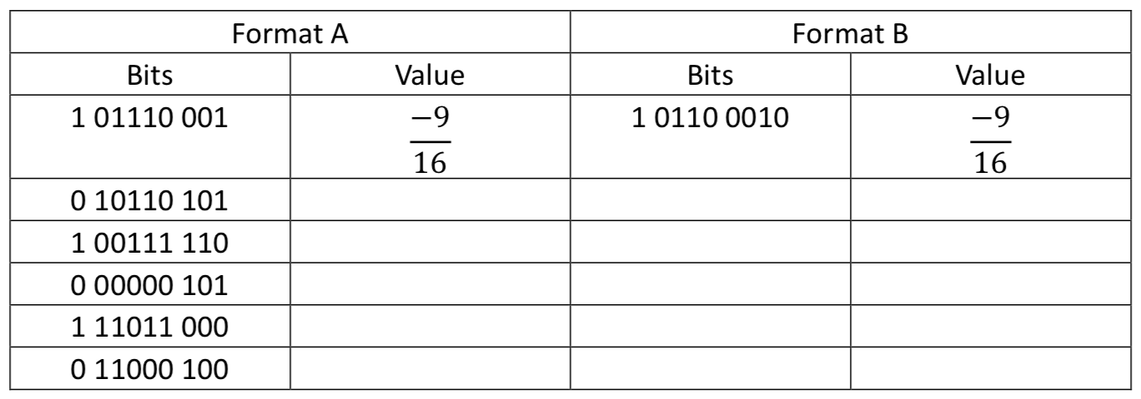
Homework5
题目4

Slide 12
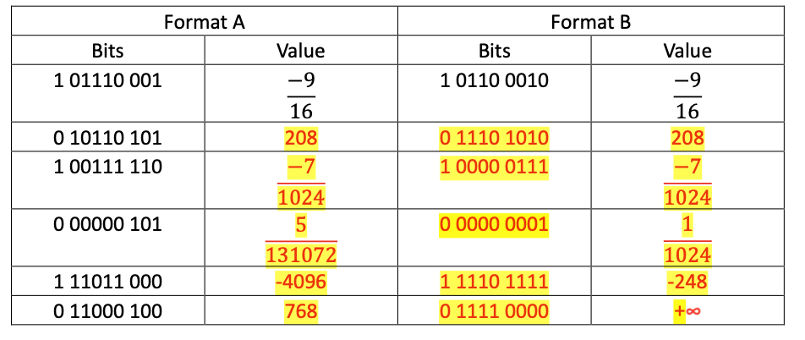
题目4答案

