Slide 1
Homework4

Slide 2
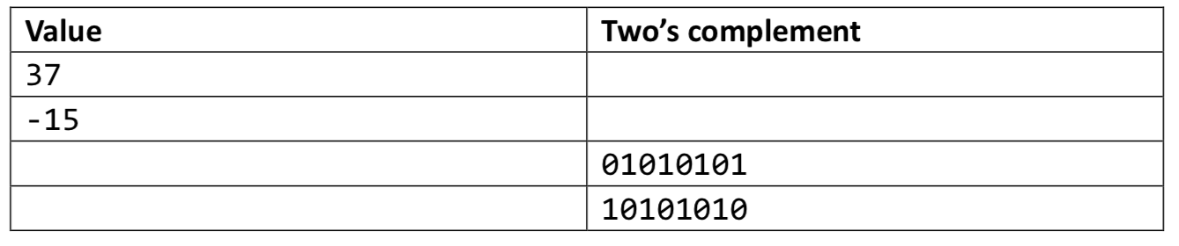
Homework4
题目1
  Assume we have an integer type of 8 bits, fill in the table below.

Slide 3
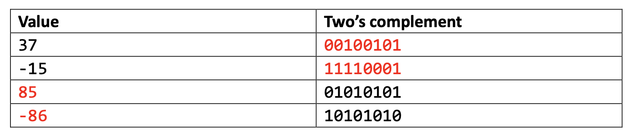
题目1答案

Slide 4
Homework4
题目2
  Consider the following C expressions:
    short s = -3;
    unsigned short us = s;
    int i = -52;
    unsigned int ui = i;
  Assume we are running code on 8-bit machine using two’s complement for singed integers. Also assume that right shift of signed values are performed arithmetically. A “short” integer is encoded 4 bits. Fill in the table below.

Slide 5
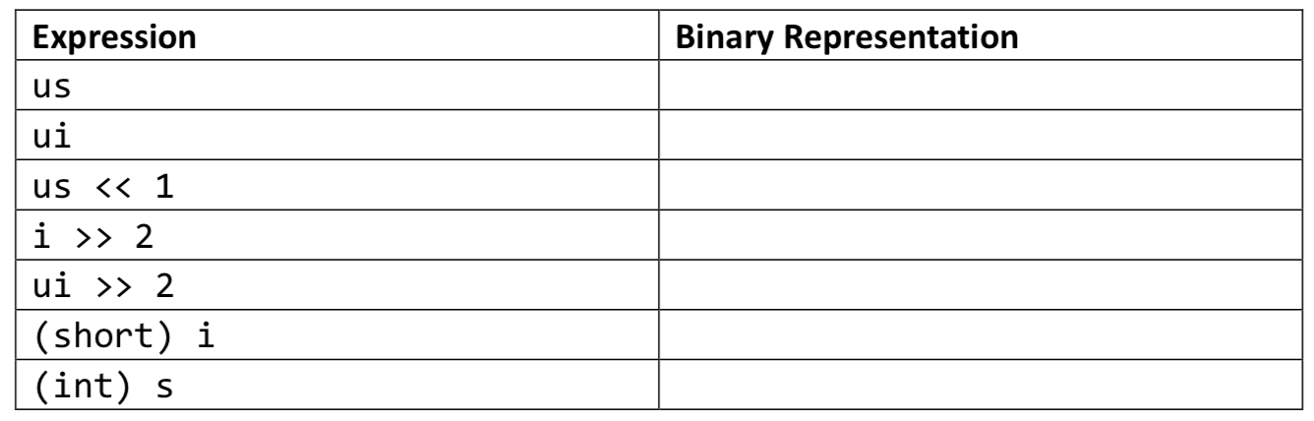
Homework4
题目2

Slide 6
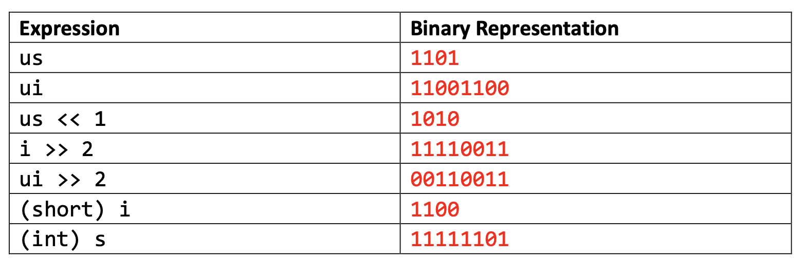
题目2答案

Slide 7
Homework4
题目3
  Write a function with the following prototype:
  / * Determine whether arguments can be added without overflow
  * This function should return 0 if arguments x and y can be added without causing overflow
  */
  int uadd_ok(unsigned x, unsigned y);

Slide 8
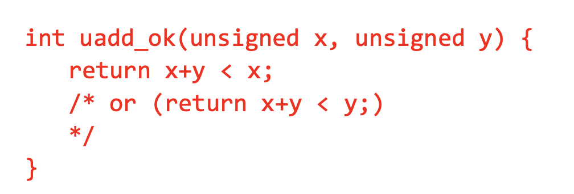
题目3答案

